Slide 1
CSCI 347: Data Mining
Course orientation

Slide 2

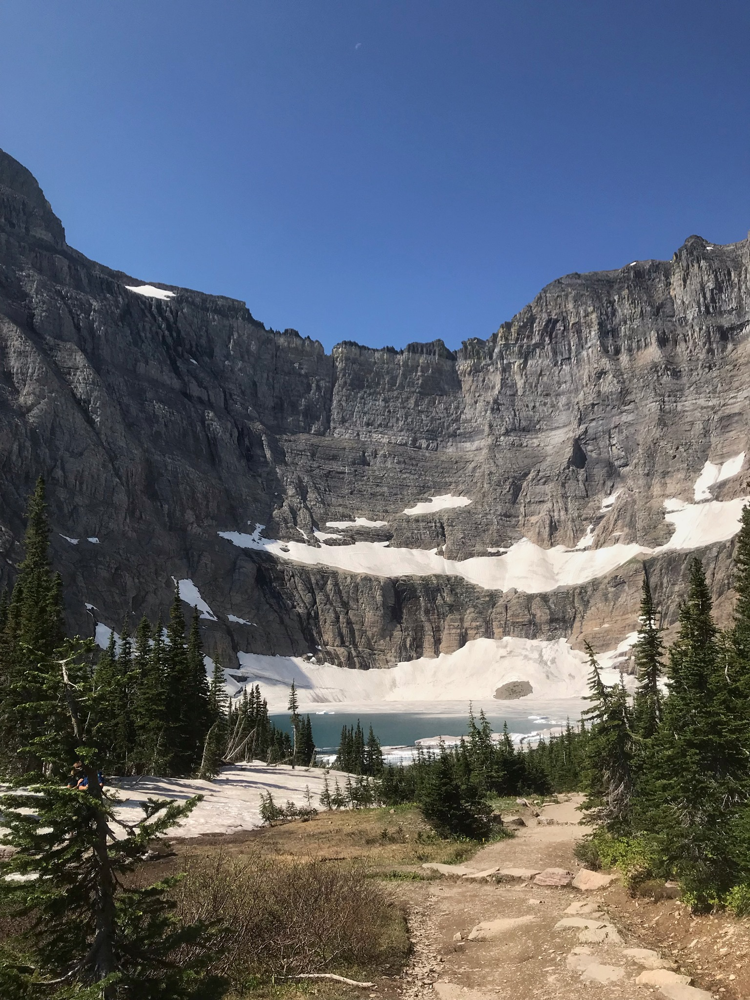
Instructor details
Adiesha Liyanage
Email: a.liyanaralalage@montana.edu
Office hours:
Monday 12:00 PM- 02:00 PM
Tuesday 10:00AM - 11:00 AM
Office: Barnard 349 (right next to conference room)

Slide 3
TA details
Name: TBD
Email:
Office hours:
TBD

Slide 4
Activity
Let’s go around the class—please tell us your name, where you’re from (City/State), and your major and something fun you did during the winter break.

Slide 5
What is Data Mining?
“the process of finding valid, novel, useful, and potentially understandable patterns in data” — G. Piatetsky-Shapiro, KDnuggets
“algorithms for learning, analysis, data management and visualization of large datasets” — C. Faloutsos, CMU
“Discovery of useful, possibly unexpected, patterns in data” — J. Ullman, Stanford
“providing tools to discover knowledge from data” - J. Han in his textbook, Data Mining: Concepts and Techniques
“the process of discovering insightful, interesting, and novel patterns, as well as descriptive, understandable, and predictive models from large-scale data” — M. J. Zaki and W. Meira Jr. in Data Mining and Analysis: Fundamental Concepts and Algorithms

Slide 6
Like how mining gold is digging through earth and rock for the valuable bits, Data mining is sorting though large data sets to find valuable information.
Marketing
Risk Management
Fraud detection
Cybersecurity
Medical diagnosis

Slide 7
Process of Data Mining
Decision making
Data presentation – visualization
Data mining – Information discovery.
Data exploration – statistical summary, querying and reporting
Preprocessing – Data cleaning using statistical techniques or data mining algorithms.
Selection of data sources
Notes:
Imagine you are at Netflix, the boss tells you to create a system that would recommend movies/tv series to users.
Decision:
Which movies or shows should appear on your Netflix homepage right now?
Key points:
Decision is personalized
Happens millions of times per day
Must be fast and automated
Ask:
What happens if this decision is bad?
Step 2: Data Presentation – Visualization
What Netflix shows you:
Ranked rows: “Because you watched…”
Thumbnails tailored to the user
Categories like “Top Picks for You”
Explain:
This is not raw data
It’s a visual summary of a model’s output
Visualization = turning decisions into human-interpretable form
Key idea:
Even perfect models fail if results are poorly presented.
Step 3: Data Mining – Information Discovery
Now ask:
How does Netflix know what to recommend?
Introduce data mining here:
Examples of discovered patterns:
Users who watched A and B often watch C
Users cluster into taste groups
Certain shows predict binge behavior
Map to tasks:
Classification: Will the user like this?
Clustering: Group similar users
Association: “Watched together”
Prediction: Watch time, churn risk
Definition (now it makes sense):
Data mining is the process of automatically discovering useful patterns and models from large data.
Step 4: Data Exploration – Understanding the Data
Before mining, Netflix asks:
How many users?
Average watch time?
Most watched genres?
Distribution of ratings?
Missing or strange values?
Techniques:
Statistical summaries (mean, median, histograms)
Querying (“How many watched this last week?”)
Reporting dashboards
Key insight:
You don’t mine data you don’t understand.
This step is human-driven, not automated.
Step 5: Preprocessing – Cleaning and Transforming Data
Explain a problem:
Raw Netflix data is messy.
Examples:
Users abandon shows after 2 minutes
Devices disconnect
Duplicate user IDs
Inconsistent ratings behavior
Preprocessing includes:
Removing noise (e.g., accidental clicks)
Normalizing watch times
Handling missing values
Feature engineering (e.g., “completion rate”)
Important inductive point:
Most effort is spent before data mining.
Step 6: Selection of Data Sources (Start Even Earlier)
Ask:
What data does Netflix even have?
Sources:
Watch history
Search queries
Ratings / thumbs up
Device type
Time of day
Location (coarse)
Also:
What data shouldn’t be used?
This introduces:
Data relevance
Privacy
Bias

Slide 8
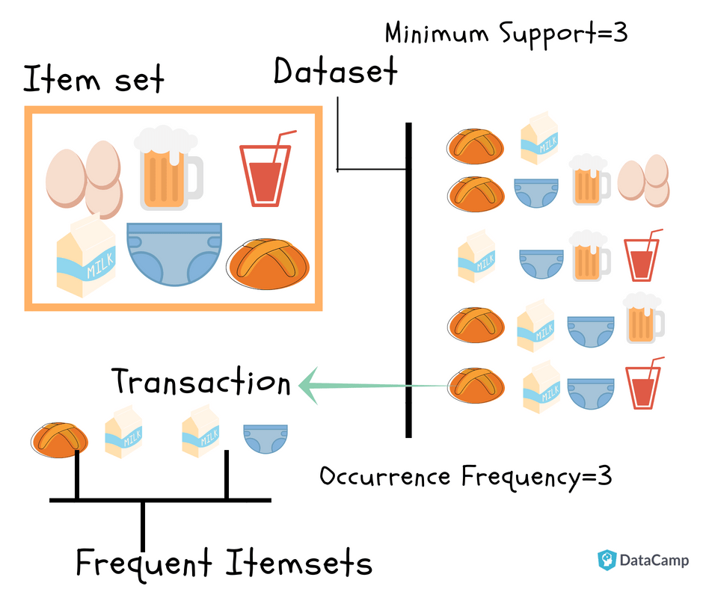
Data Mining Application: Market basket Analysis
https://www.datacamp.com/tutorial/market-basket-analysis-r

Slide 9
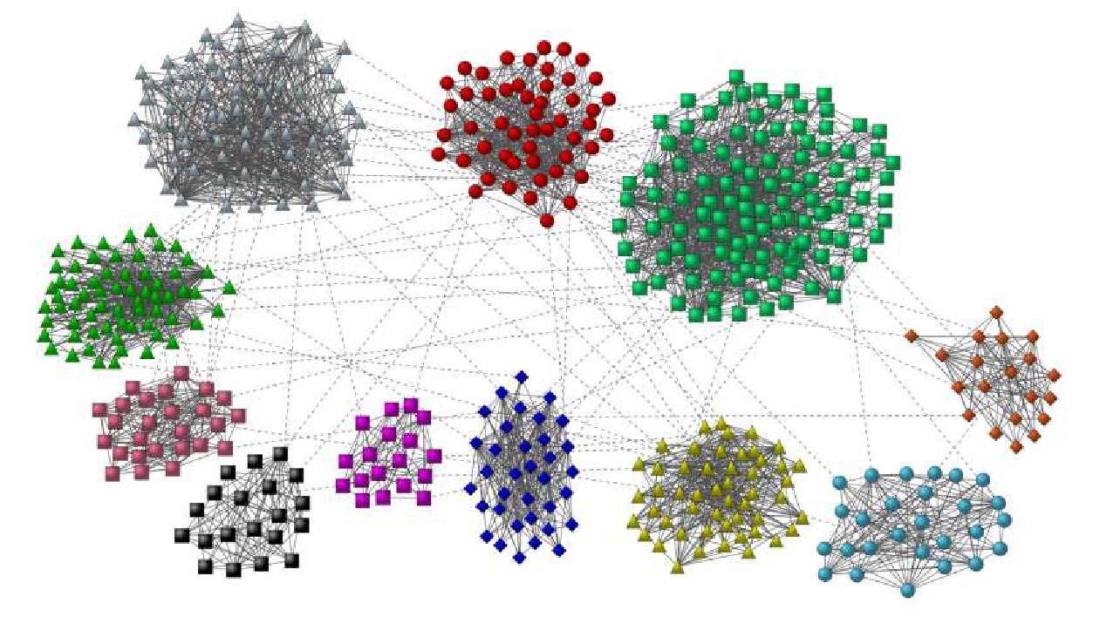
Data Mining Application: Finding communities in social network
Image taken from: Community detection in graphs, Fortunato, Santo

Slide 10
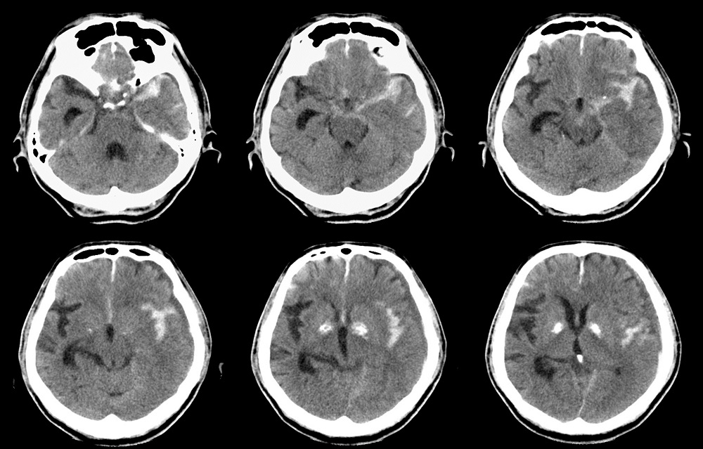
Data Mining Application: Anomalies in healthcare data
Deep learning algorithms can identify abnormalities on head computed tomography (CT) scans in patients who present with head trauma or stroke symptoms, according to study results published in the Lancet*.
https://www.thelancet.com/journals/lancet/article/PIIS0140-6736(18)31645-3/fulltext

Slide 11
Concept Maps
“Concept map is a graphical tool for organizing and structuring knowledge by depicting concepts as nodes, and relationships between concepts as edges” – Wei et al. in Concept mapping in computer science education.

Slide 12
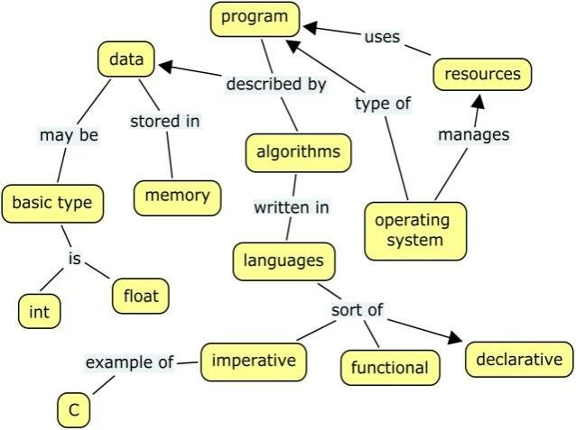
Example concept maps
CM for operating systems - An Evaluation Methodology for Concept Maps Mined from Lecture Notes: An Educational Perspective

Slide 13
Activity: Let’s create a data mining concept map
CM helps to visualize important concepts related to a theme.
Work with people around you.
Think about following questions:
What are applications in data mining ?
What are the foundational skills required to be an expert in this area ?
Programming languages
Mathematical skills etc.
What are the topics related to Data mining that comes to your mind?
What are challenges in Data mining ?

Slide 14
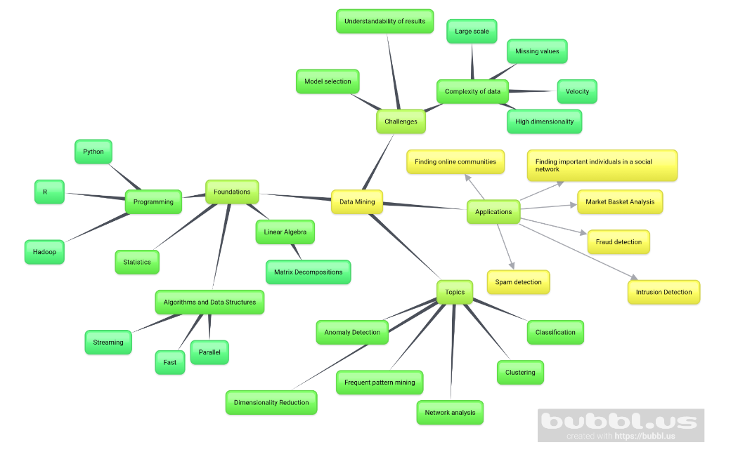

Slide 15
Summary
Topics: Common data formats, exploratory data analysis, data preparation, graph analysis, dimensionality reduction, clustering, classification and few advanced topics.

Slide 16

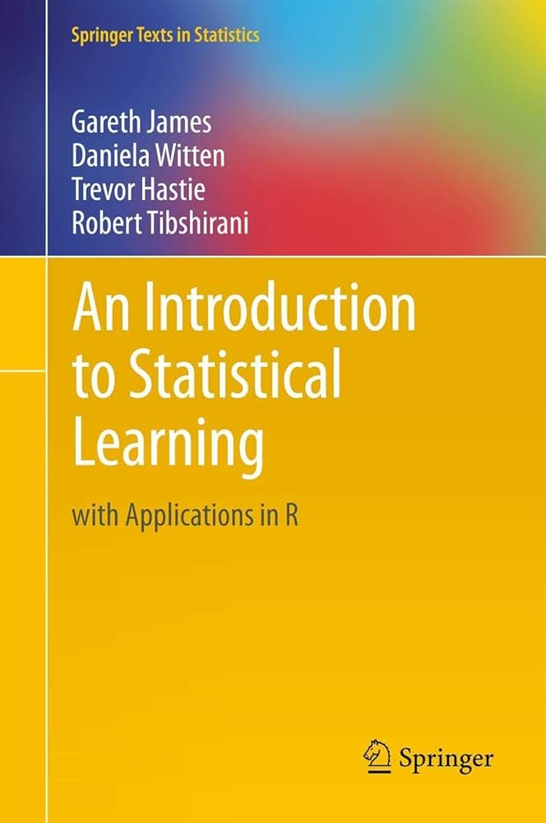
Textbooks
Data Mining and Analysis: Fundamental Concepts and Algorithms by Mohammed J. Zaki and Wagner Meira, Jr.
Optional: An introduction to Statistical Learning (ISLR)

Slide 17

Programming Language and Software
We will use Python as the programming language
We use Jupyter Lab as the IDE for the course, please make sure that you have installed this before the next session.
https://www.datacamp.com/tutorial/installing-jupyter-notebook
Have your laptop with you for in-class activities.

Slide 18
Communication
Post your questions on MSU CSCI Discord channel.
CSCI-347-DATA-MINING (CATEGORY)
I will post the material on Canvas.
I will use GitHub page for updating the course schedule.
https://github.com/adiesha/CSCI347Spring2026

Slide 19
Pre-requisites
Students are expected to have taken statistics/probability course and have basic working experience in programming.

Slide 20
Evaluation and grading
Grading | Weight of each category (from 100)
Quizzes | 10
Attendance | 6
Assignments | 30
Mini projects (3 projects) | 24
Mid-term exam | 10
Final Project | 20
Bonus (depending on the situation and this is entirely up to me) | Up to 2
Total | 100 + (up to 2)

Slide 21

Quizzes
Canvas weekly or per topic quizzes (you can expect lot of quizzes)
But these quizzes will be relatively short.
No makeup quizzes, I will drop lowest quiz from your overall grade.

Slide 22
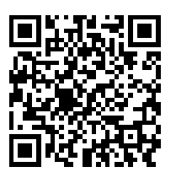
Attendance
6% of your grades would be attendance.
If you have 80% of the attendance, then you will get full grade for your attendance score.
We will use iClicker to record attendance.
This is a free service.
Use the following link to register for the course.
https://join.iclicker.com/ZABU
Register one device for iClicker attendance.
At start of each class, you must use your device to record attendance.
If you encounter problems with registration talk with UIT.

Slide 23
Attendance
Please do not come to me at the end of the semester and tell me that you could not get the iClicker working.
Resolve these issues in the beginning of the semester.
The attendance server is run automatically during the class time, this would include holidays, I will remove these days manually from the server so do not worry about them.
During the tests you do not have to record attendance.

Slide 24
Assignments
There will be written assignments about every other week or after completing each chapter.
The assignments should be turned in on Canvas.
For coding parts of the assignments, you can submit the JupyterLab files along with other written materials.

Slide 25
Mini Projects
There will be 3 mini projects.
They should be submitted as a well-commented report in PDF format along with your code.
The mini-projects should be completed in teams of 3-4 members.
This is a must. Since we have lot of students, individual project grading is too much for the TA for timely grades.
If you create groups of 1 or 2 people, then there will be a penalty.
Only one submission is required. (Multiple submissions by different people will result penalties)

Slide 26
Mid term test
There will be one in-class mid-term exam in this course.
I will announce the exact exam dates later.
If you need accommodations, please let me know before the exam.
Roughly, speaking exam would be in April. (I will announce the dates later)

Slide 27
Final project
Students should propose a data mining problem and dataset and offer a solution using the methods we learn in class.
Groups of 3-4 students.
More information will be shared during the semester.

Slide 28
Special needs and accommodations
If you have a documented disability and need or might need any accommodation, please reach out to the Office of Disability Services as soon as possible.
They will instruct you on what you need to do to get accommodation for this class.

Slide 29
Course survey and evaluation
If 70% of the students complete the course survey and evaluation, all the students will get some bonus points. (I will decide the exact value of the bonus points; you can expect it to be between 0.25—0.75).

Slide 30
Classroom etiquette
Please note that, disruptive behavior during the class time will not be tolerated and will result in such disruptive students being asked to leave the lectures.
Please be kind and respectful to other students in the class.
I will add more requirements here if it deems appropriate.

Slide 31
Course schedule
https://github.com/adiesha/CSCI347Spring2026

Slide 32
Assignment 0 – About You
Please update your canvas photo.
Please create a single slide with the following information.
Your name (with pronunciation hints).
Hometown/Country (optional).
Your major.
One thing you would like to learn from this course.
One interesting fact about you.
Convert it to a pdf and submit it.

